Slide 1
Edgewater Wireless
We make WiFi. Better.

Slide 2
Edgewater Wireless
Multi-Channel WiFi
Innovator in high density WiFi solutions & technology Multi-Channel Single Radio (MCSRTM) WiFi Products
Pioneering development of interference mitigation in WiFi
20+ Patents in our core technology
Over $60M invested in technology development
Global presence in USA, Canada and Europe
Publicly listed: YFI; TSX-V

Slide 3
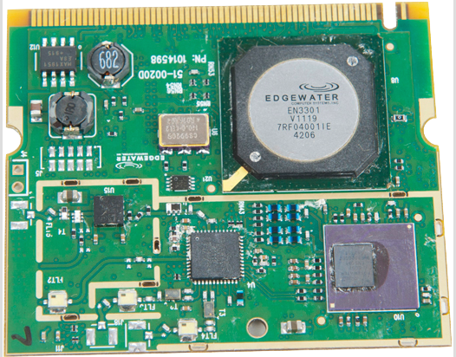
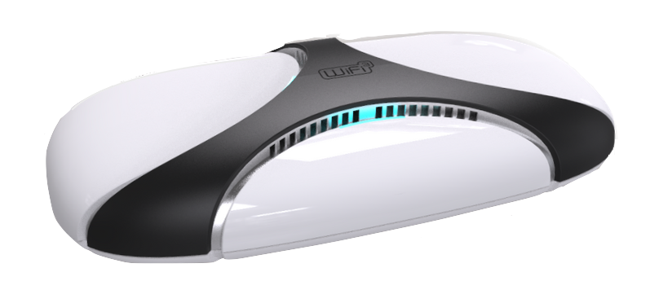
Edgewater Wireless
Multi-Channel WiFi Silicon Solutions
• Revolutionary high-performance silicon solutions, backed by 20+ patents
• MCSRTM 802.11 standards compliant WiFi support
•Delivers multiple, concurrent channels of transmit & receive from a single, WiFi Standards compliant radio (2.4 and 5 GHz)
•Industry leading interference mitigation technology (ACI/CCI)

Slide 4
Edgewater Wireless
WiFi3TM Features
Multi-Channel Air Interface
WiFi3TM offers the highest channel density in the industry, unlocking maximum frequency reuse & delivers the highest capacity with the fewest access points
PowerZoningTM
Enables Tx power on a per channel basis, creating defined coverage areas in high-density applications and optimizing performance vs traditional single channel radios
Spectral Surveillance (SSATM)
On-board, real-time wide-band RF monitoring capabilities identify sources of interference or rogue hackers – remotely without interrupting Tx/Rx traffic
MESHDTM Active Mesh Technology
Multi-Channel mesh capabilities deliver 7x performance gains over single channel radio architectures – optimal performance of both mesh and access

Slide 5
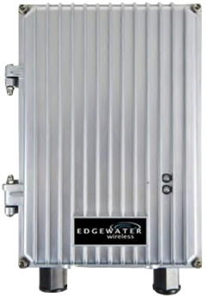
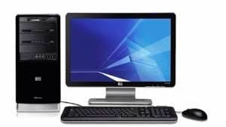
Edgewater Wireless
Comprehensive high-density WiFi Solutions
Outdoor Access Points
Indoor Access Points
Access Point Products
EdgeNET NMS
EdgeNET Controllers
Controller & Network Management
WiFi3TM over DAS
Small Cell LTE + WiFi3TM
OEM & Licensing
Service Management Partners
Access Control
Access Gateway Partners

Slide 6
Edgewater Wireless
WiFi3TM For Increased Channel Density
Powered by:
User Density
Density of Users
3-Channel
4-Channel
6-Channel
12-Channel
Edgewater Wireless Product Family

Slide 8
Edgewater Wireless
WiFi3TM vs Single Channel Error Rates
Real-world, open-air test environment in a typical enterprise or carrier environment
Comparison between single channel vs multi-channel WiFi3TM architectures
Comparison test used a top-ranked 802.11AC Access Point (Netgear) vs entry-level WiFi3TM powered AP delivering 3-channels (Edgewater)
Testing utilized 10 off-the-shelf smart phones and tablets downloading
Retransmission rate %
Legend:
9:30 9:45 10:00 10:15 10:30 10:45 11:00
Lapse Time
WiFi3TM Channel 1
WiFi3TM Channel 6
Entry-level 3-channel (2.4GHz) AP without optimization. Same 10 users using the same mix of standard user devices.
WiFi3TM Channel 11
Competitor AP

Slide 9
Edgewater Wireless
WiFi3TM vs????
Competitor’s AP, using single channel radio architecture, must support 10 clients on a single channel
Edgewater’s WiFi3TM powered AP enables balanced distribution of clients across multiple channels
Number of Clients
Legend:
WiFi3TM Channel 1
WiFi3TM Channel 6
9:30 9:45 10:00 10:15 10:30 10:45 11:00
WiFi3TM Channel 11
Lapse Time
Competitor AP

Slide 10
Edgewater Wireless
Download Rate Comparison???
As users are added to the Competitor’s AP, using single channel radio architecture, performance degrades to unmanageable levels
Edgewater’s WiFi3TM powered AP delivers the highest performance to the most users in real-world scenarios (density & interference)
Download rate (Kbts/s)
Legend
9:40 10:00 10:20 10:40 11:00
WiFi3TM Channel 1
Lapse Time
WiFi3TM Channel 6
WiFi3TM Channel 11
Competitor AP

Slide 11
Let’s look at a real world example….

Slide 12
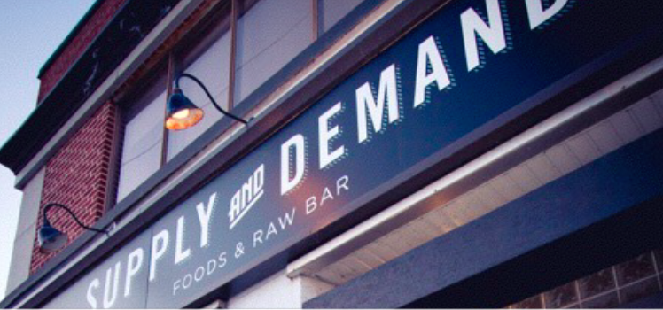
Edgewater Wireless
Hospitality
PROBLEM: Restaurant providing high quality food that uses WiFi for it’s phones, computers, point of sale devices and WiFi access for guests. Traditional WiFi access point can not cope with density and interference, which was costing Supply and Demand money and time
SOLUTION: Edgewater Wireless deployed a single Access Point and placed the reservation app & the music streaming service on its own channel. This significantly improved the performance of all WiFi devices in the restaurant as well as Jenn’s business
RESULT: By installing one WiFi3TM access point, Edgewater Wireless was able to solve the density and interference issues while dramatically improving service

Slide 13
Edgewater Wireless
Real World Benefits of WiFi3TM
More Users with Fewer Access Points
Performance
Lowest Capex and Opex in the industry
Dramatic increase in network performance for high-density or high-interference applications
Service Delivery
End-user Satisfaction
Channel density results in a future proof platform for service deliver – voice, video and more
Delivering the highest quality of service to the most users means fewer truck rolls and lower customer care costs

Slide 14
Financial Value Proposition
50% Lower Cash Cost
75% Lower Staff Cost
Traditional WiFi
Traditional WiFi
CAPEX
Deployment
5 year OPEX
Maintenance
Edgewater WiFi
Troubleshooting
Edgewater WiFi
High Density WiFi Application
Average high-density WiFi Deployment

Slide 15
Let’s talk about the engineering problem….

Slide 16
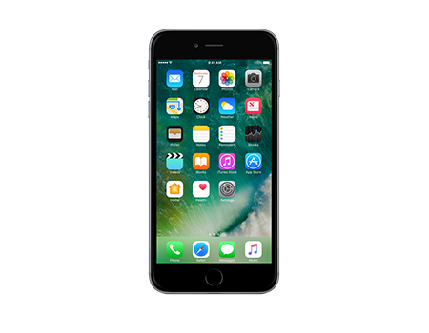
Edgewater Wireless
Why doesn’t my access point from Vendor X do the job? It’s got the latest 802.11n/ac/ax, a controller and is supposed to be the greatest!?
Happy Home User
Grumpy Enterprise User
Angry Mob
Happy Home User
Increasing user density
Decreasing performance

Slide 17
Edgewater Wireless
What’s really happening?
Traditional, single channel WiFi solutions were designed for the home market
Easy Deployment
Fewer Users
Little Interference
Close proximity to AP

Slide 18
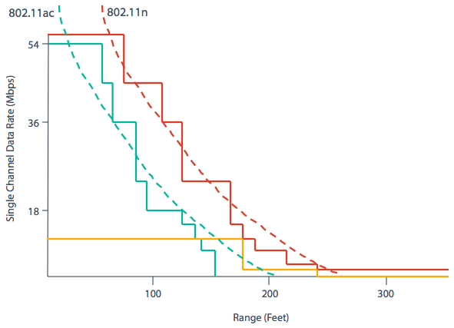
Edgewater Wireless
It’s not your home WiFi…
High-density WiFi applications are very different. They have a large number of simultaneous users and varying distance from access points.
Traditional WiFi approach is not designed with high-density in mind, which results in declining date rates.
Legend:
802.11a
802.11b
Data rates decline as distance from AP increase
802.11g

Slide 19
Edgewater Wireless
19
Interference
Interference
High-density WiFi applications are very different …
More users require more access points – right?
Why is the QoS so poor?
Large number of simultaneous users
Varying distance from access points
More access points = increase interference
Single-channel WiFi approach is not designed with high density in mind - resulting in declining performance and data rates
Interference
Interference
AP

Slide 20
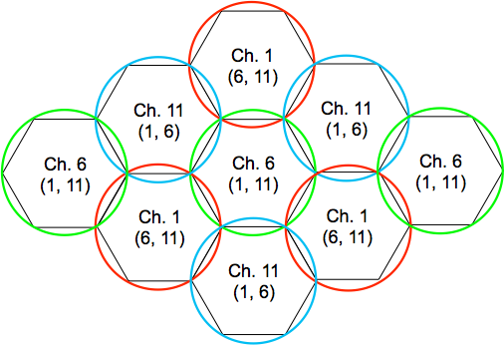
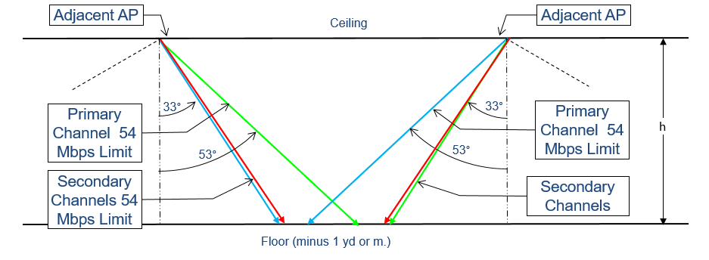
What’s the solution?
Address the root cause of the issue:
Increase the channel density to support greater number of users
Mitigate interference
Maximize channel re-use
Build a superior solution using a multi-channel chipset and radio card to manufacture a new access point designed to handle mass number of users in a high density environment
Adjacent AP
Ceiling
Adjacent AP
Primary Channel 54 Mbps limit
Primary Channel 54 Mbps limit
Secondary Channel 54 Mbps limit
Secondary Channel 54 Mbps limit
Floor (minus 1 yd or m)

Slide 21
Edgewater Wireless
Edgewater Wireless Systems Inc.
408 Churchill Ave., North
Ottawa, Ontario
Canada
Global Presence:
USA, Canada and Europe
www.edgewaterwireless.com
+1 613 271 3710

